Slide 1
Week 2 – lesson 1

Slide 2
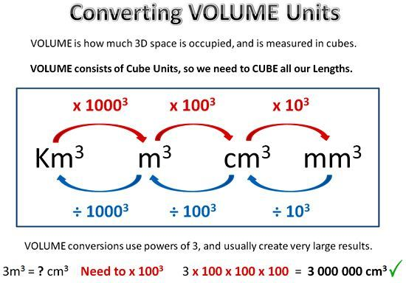
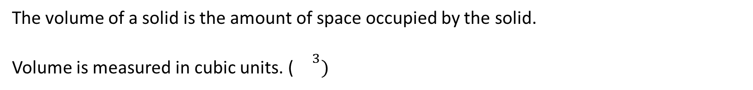
EQ: how do we measure volume?
TOPIC: measurement
What is volume?
The volume of a solid is the amount of space occupied by the solid.
Volume is measured in cubic units. (${}^{3})$

Slide 3
Week 2 – lesson 2

Slide 4
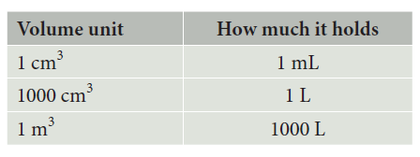
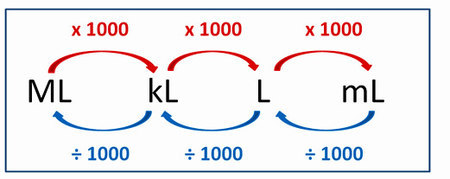
EQ: how do we differentiate between volume and capacity?
TOPIC: measurement
What is the difference?
Volume measures the amount of space inside a container –> measured in cubic units
Capacity measures the amount of liquid or gas a container will hold -> measured in mL, L, kL, ML

Slide 5
Week 2 – lesson 3

Slide 6
Mathematical Thinking Process Planning Sheet
Interpret the task
Identify the mathematics involved
Analyse information/data (you may need to use other sources)
Apply existing mathematical knowledge and strategies
Verify the reasonableness of your answer

Slide 7
Week 2 – lesson 4

